Slide 1


Slide 2
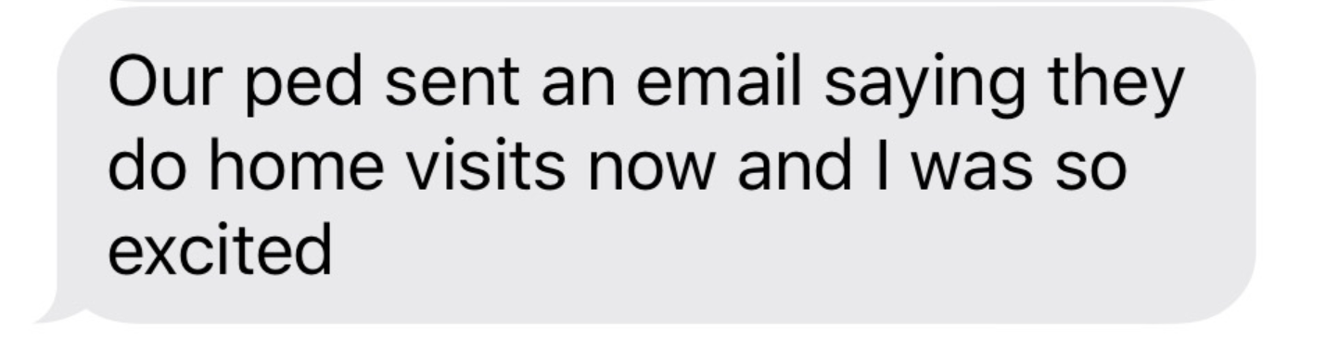
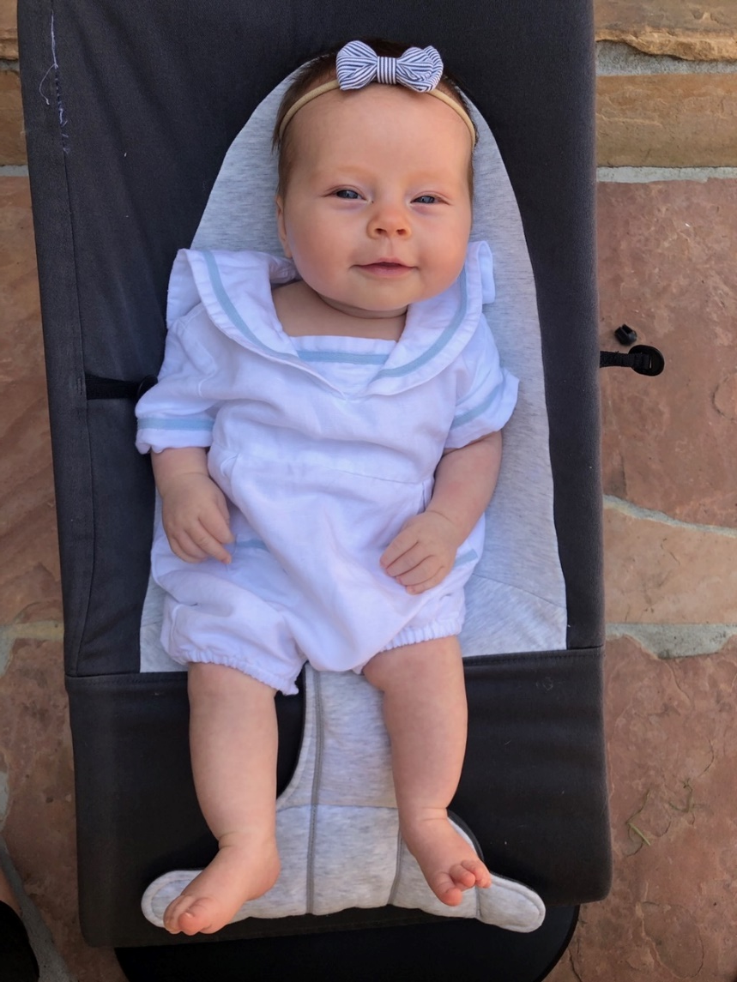
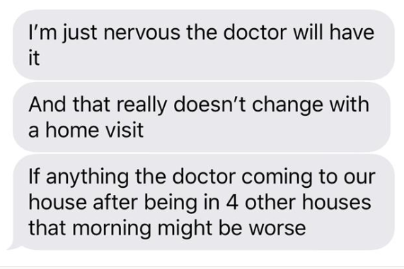
The Problem

Slide 3
Fewer childhood vaccines have been given as a result of the COVID-19 pandemic.
To avoid outbreaks of vaccine-preventable diseases and keep children safe, vaccinations are essential.
177 million +
worldwide may miss out on measles vaccine
(WHO, 2020).
2.5 million
U.S. children have ALREADY missed vaccines
(CDC, 2020).
Notes:
As Covid-19 continues to spread globally over a 117 million children in 37 countries may miss out on receiving measles vaccine
2.5 million children in the US have ALREADY missed needed vaccines.

Slide 4


The Solution: A Nurse-Led Home Vaccination Service
MD/NP writes eRX
Pharmacy pick-up or delivery
Parent scans QR to schedule visit via app
Vaccine administration recorded through App
Data are sent to EHR and CIR
Nurse telehealth visit
3-prong approach
Integrated Data Flow
Auto-injector
App
Notes:
Report MD/NP writes eRX and schedule virtual visit​
Alert sent to Patient re Visit and Pharmacy Delivery
Telehealth Visit Conducted
Vaccine Administration Recorded Through App
Data are sent to EHR and CIR

Slide 5
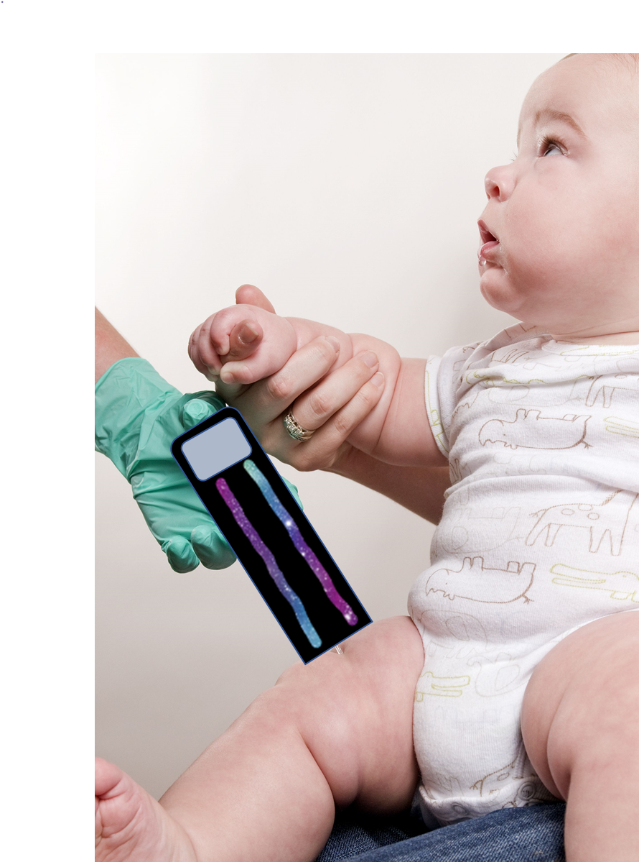
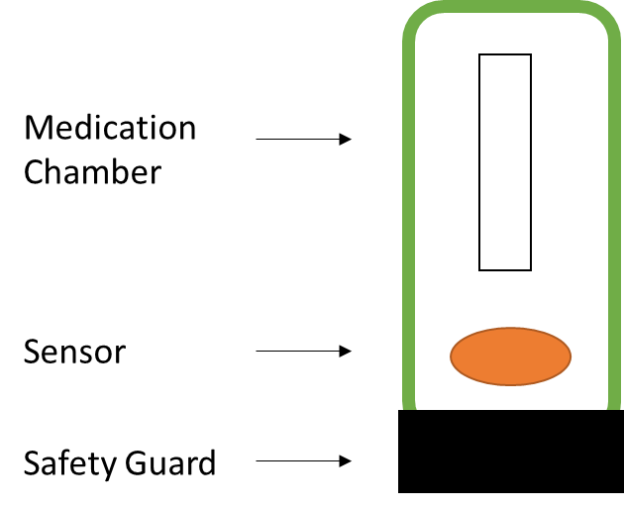

Auto-injector

Slide 6
SMART on FHIR App
Vaccine Administration Video
Video
Assess
Educate
Support
Document
Integrate
FAQ’s
Vaccine Info Sheets
QR Scan
Nurse Telehealth Appointment
6/08/20 10:00 AM

Slide 7





Data Flow
SMART on FHIR Application (pt use)
EHR and/or Citywide Immunization Registry
Device
Azure API for FHIR
FHIR Dashboard
(clinician use)
Azure Storage

Slide 8

Nurses are poised to protect

Slide 9
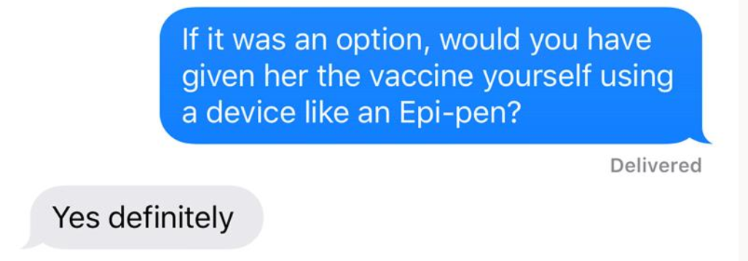

Slide 10
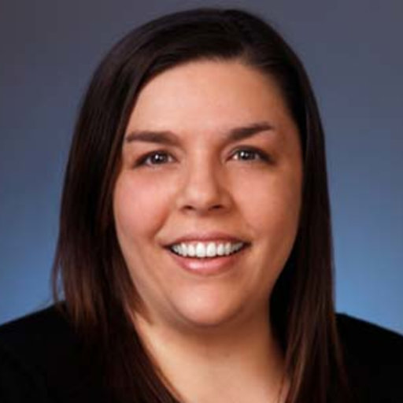
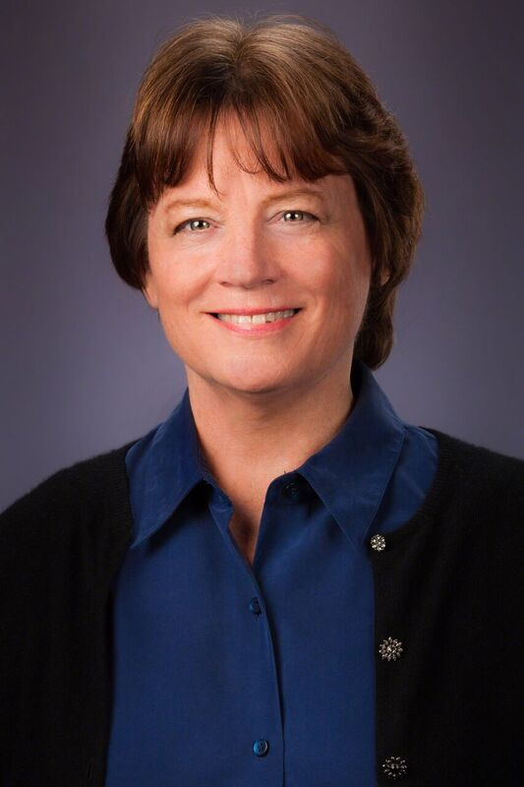
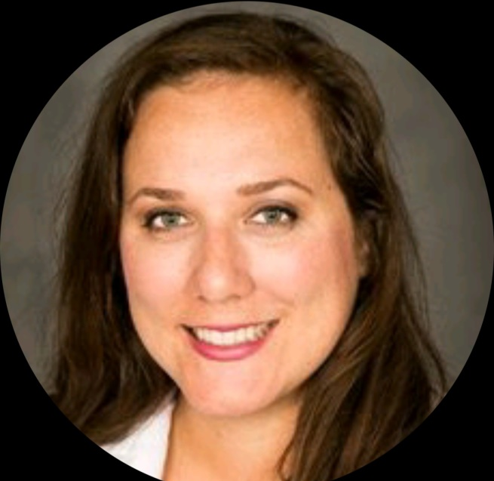
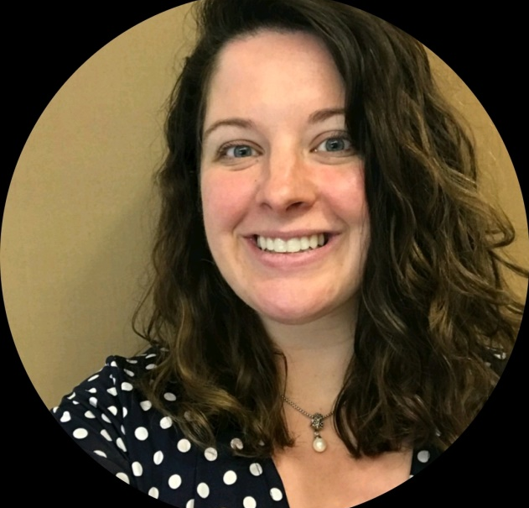
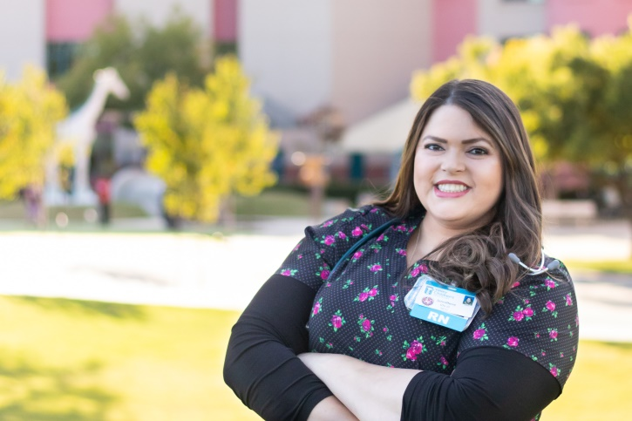
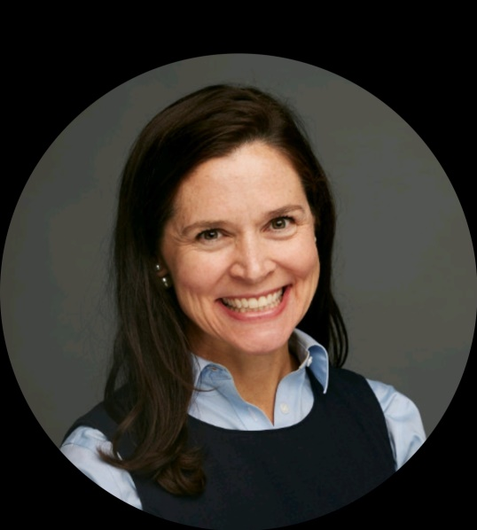
Jennifer Hayakawa
PEDIATRIC CNS
Brittney Anderson
PEDIATRIC NP
Joan Widmer
NHNA President
Briana White
Nurse Manager PEDIATRIC clinics
Victoria Tiase
Nurse Informaticist
PEDIATRIC asthma
Jennifferre Mancillias
NEONATAL ICU RN
Notes:
We are a pediatric nurses who are not trying to re-invent the wheel, just re-imagine it! By putting all of the pieces together in a way that allows us to take care of our Children, YOUR children and make vaccines more accessible.
And when Johnson & Johnson announces they have a COVID-19 vaccine we hope to answer that global call!

